Slide 1

Active Systems Pty
Vehicle Registration Manager

Slide 2

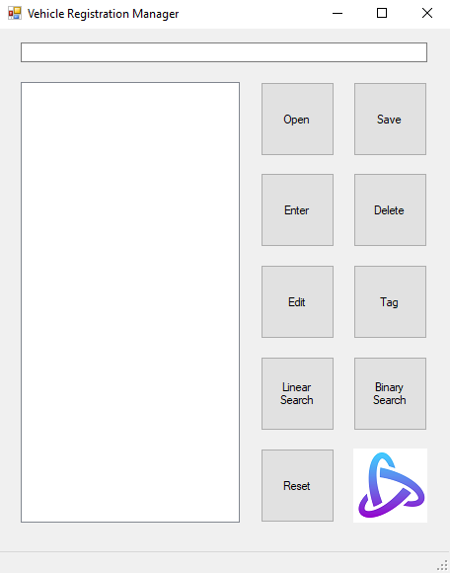
Button Layout
Active Systems Pty
Writes all list data to a text file
Loads data from a text file into the list
Removes a rego plate from the list
Adds a new rego plate
Tags and untags a rego plate with the prefix ‘Z’
Updates an existing rego plate
Utilises a binary search to find a specific rego plate
Utilises a binary search to find a specific rego plate
File related functions are placed in the first row
General data manipulation functions are placed in rows 2 & 3
Search related functions are placed in row 4
Application reset function is placed at the bottom
Resets the application by clearing all data fields
Notes:
All buttons have accompanying status strip messages when their function is executed
Buttons when hovered over will display a tool tip message providing information about what each one does.
Company logo included in the same space as the logo due to the program only requiring 9 buttons.
In addition to the delete button, items may also be deleted by double clicking on them in the display box.
Duplicate plates cannot be entered into the application via the enter or edit buttons.
Layout is loosely based on file drop down menus from Microsoft office and Windows default calculator.

Slide 3
Load and Save Data Functions
Active Systems Pty
Closing the form will automatically increment the file name by 1 and save it
Opens file explorer allowing the user to name and save the current data set to a .txt file
Opens file explorer allowing existing data sets to be loaded into the program from .txt files
Naming convention for files requires them to be saved as ‘demo_xx’ where xx is a number eg. 00, 01, 02 etc.
Notes:
When file explorer is opened only folders and .txt files will be visible
By default the working file name is demo_00 which means the default close method save file will be demo_01

Slide 4
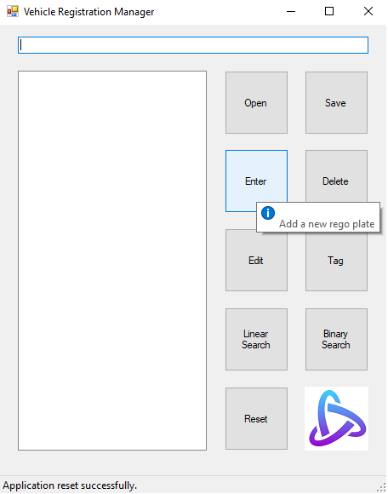
User Interface and Features
Active Systems Pty
Text box which allows users to manipulate data
All UI elements display pop-up tool tips when hovered over providing useful information
List box which displays sorted existing data
Status strip text for providing user friendly feedback and error messages
Notes:
Text box only accepts numbers and digits.
Rego plates have a maximum length of 8 characters and a minimum length of 3.
Display box updates following use of each function to ensure that visible data matches the backend List.

Slide 5
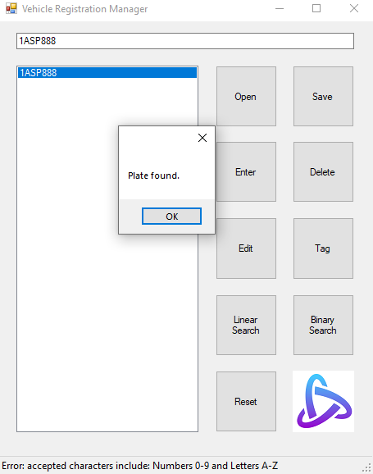
Error Messages & Confirmation Notifications
Active Systems Pty
Rego plates can be searched for via text box and if found will be selected in the display box
Usage of either of the search functions will return a message box informing the user on if the plate was found or not
All error messages are displayed in the status strip box and provide information for correction
Notes:
Error messages inform the user when they are using an element of the application incorrectly.
The linear and binary search buttons return the index of the plate the user is trying to search for if found.
Errors are denoted by the prefix ‘Error’.

Slide 6

Questions
Active Systems Pty

